Slide 1
Agenda (Afternoon)
Potential office hour 1:15 pm to 2:45 pm
Graph
Graph Basics
Breadth-first Search [Example ]
Depth-first Search
A Brief Introduction to Other Algorithms
Clever Tricks in Algorithms
Hare & Tortoise Algorithm
Algorithmic Techniques
Exercise, Q&A
Ack: Some slides materials are based on Introduction to Algorithms by Cormen et al. and Algorithms, 4th Edition by Robert Sedgewick and Kevin Wayne
Resources: https://algs4.cs.princeton.edu/home/

Slide 2
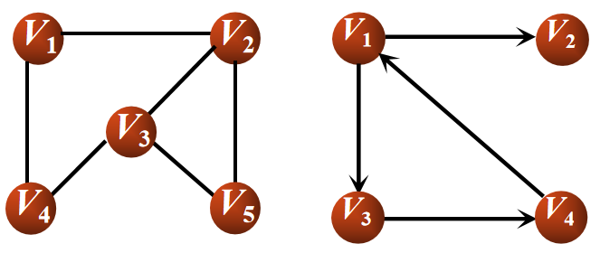
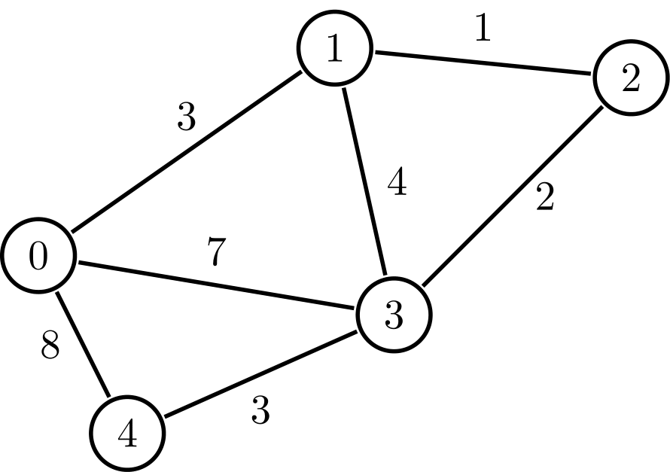
Graph Basics
Set of :
Nodes/ Vertices contains values and links to its neighbors
edges connecting the nodes
Edges can be
Undirected: no distinction between the 2 nodes
Directed: has a source and a destination
Weighted
Node
Edge
Undirected Graph
Directed Graph
Weighted Graph
Directed Graph

Slide 3
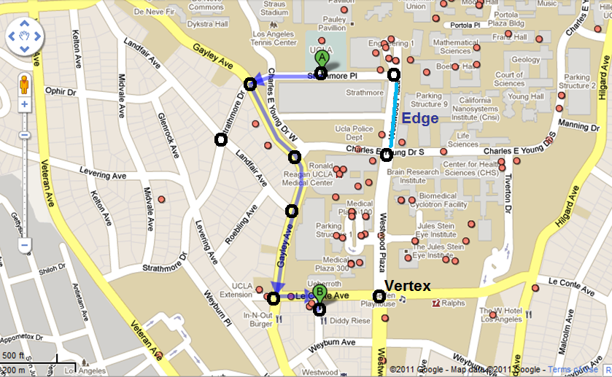

Applications - Navigation
Google Maps - determining the fastest route

Slide 4
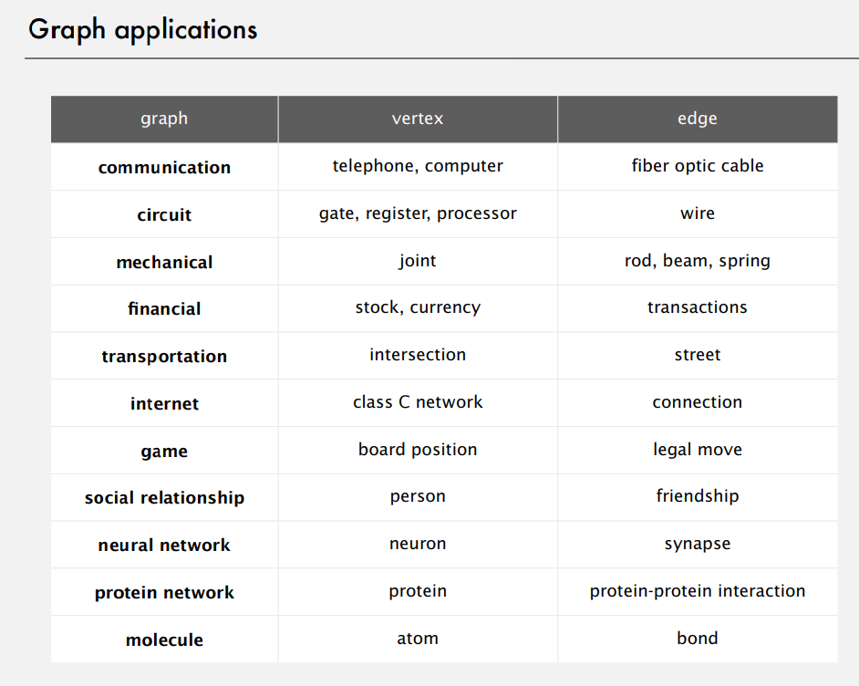

Slide 5
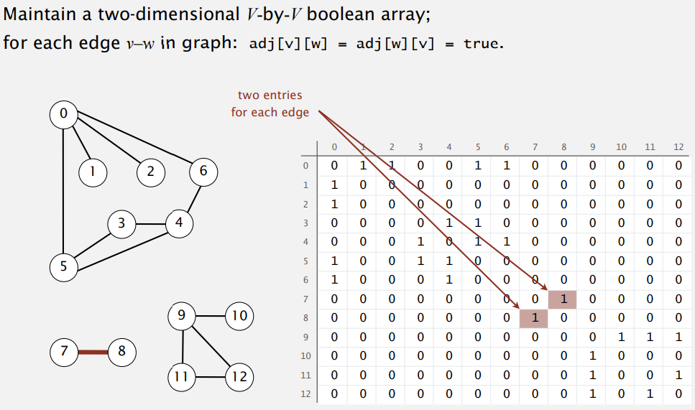
Computer Representation of Graph
Adjacent Table/Matrix: Pros/ Cons?

Slide 6
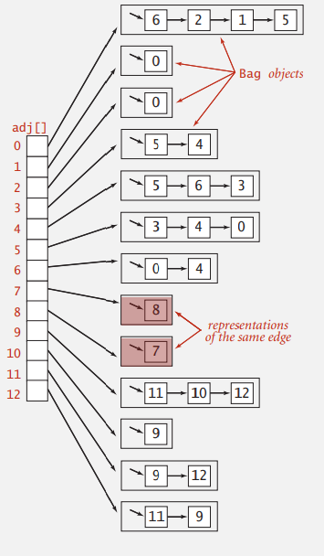
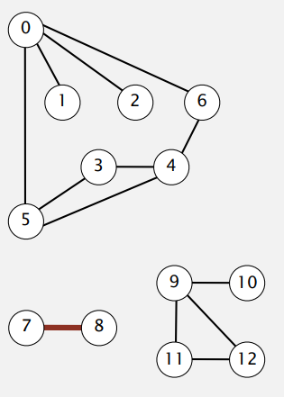
Computer Representation of Graph
Adjacent List: Pros/ Cons?

Slide 7
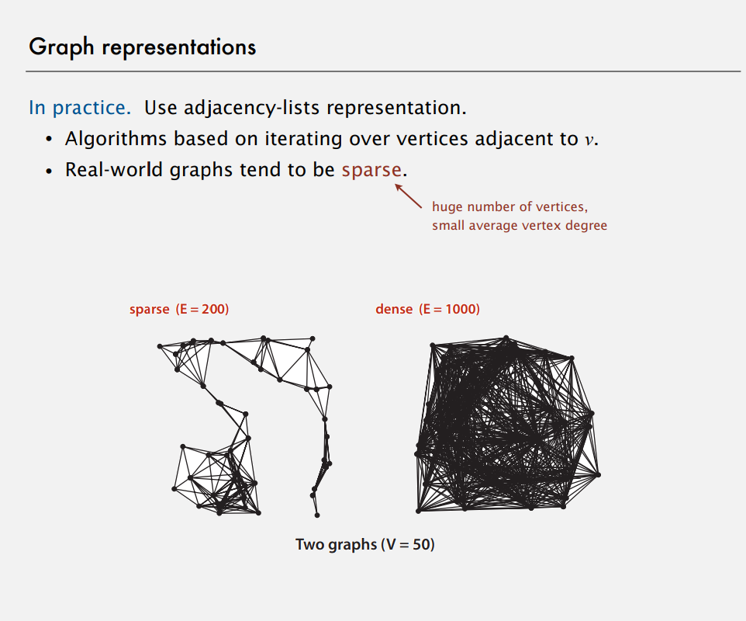

Slide 8
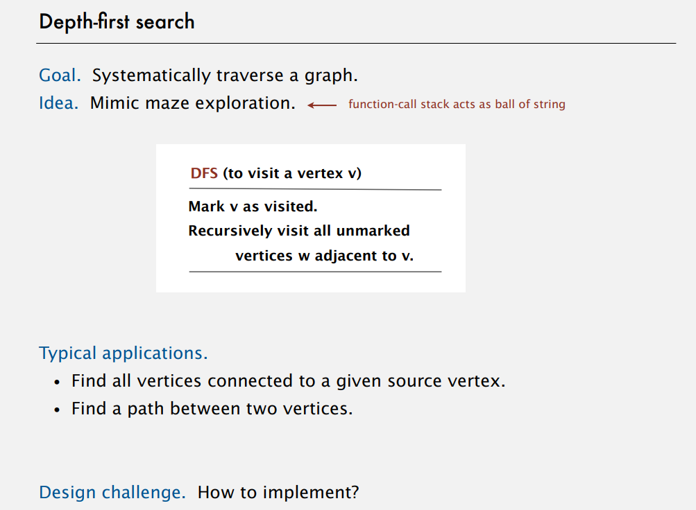
Notes:
graph represetation
adjacent table
linked list
BFS DFS

Slide 9
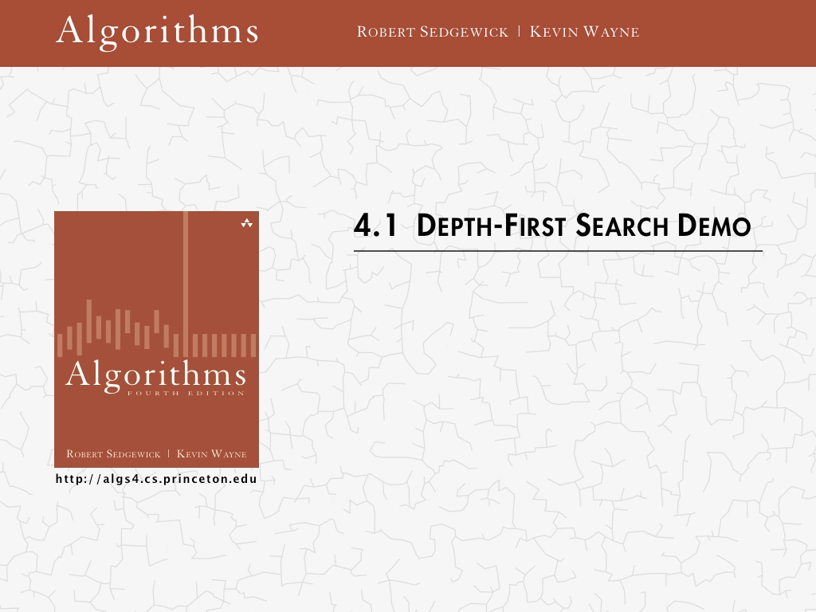
Notes:
graph represetation
adjacent table
linked list
BFS DFS

Slide 10
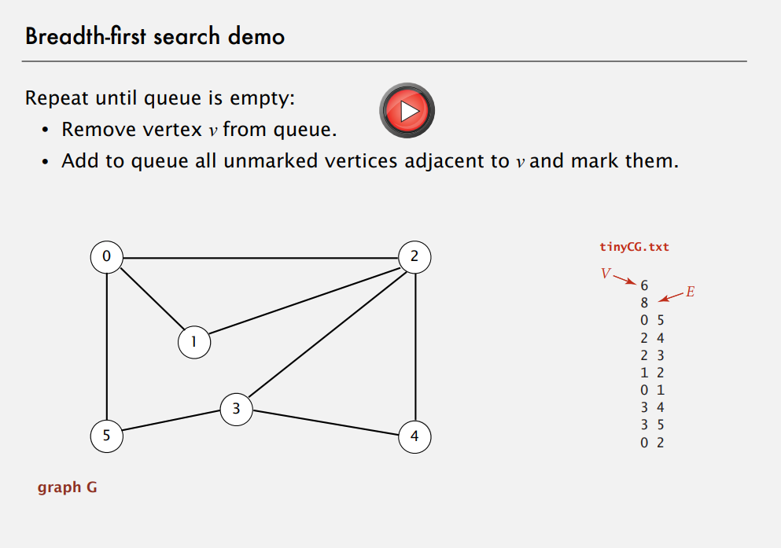

Slide 11
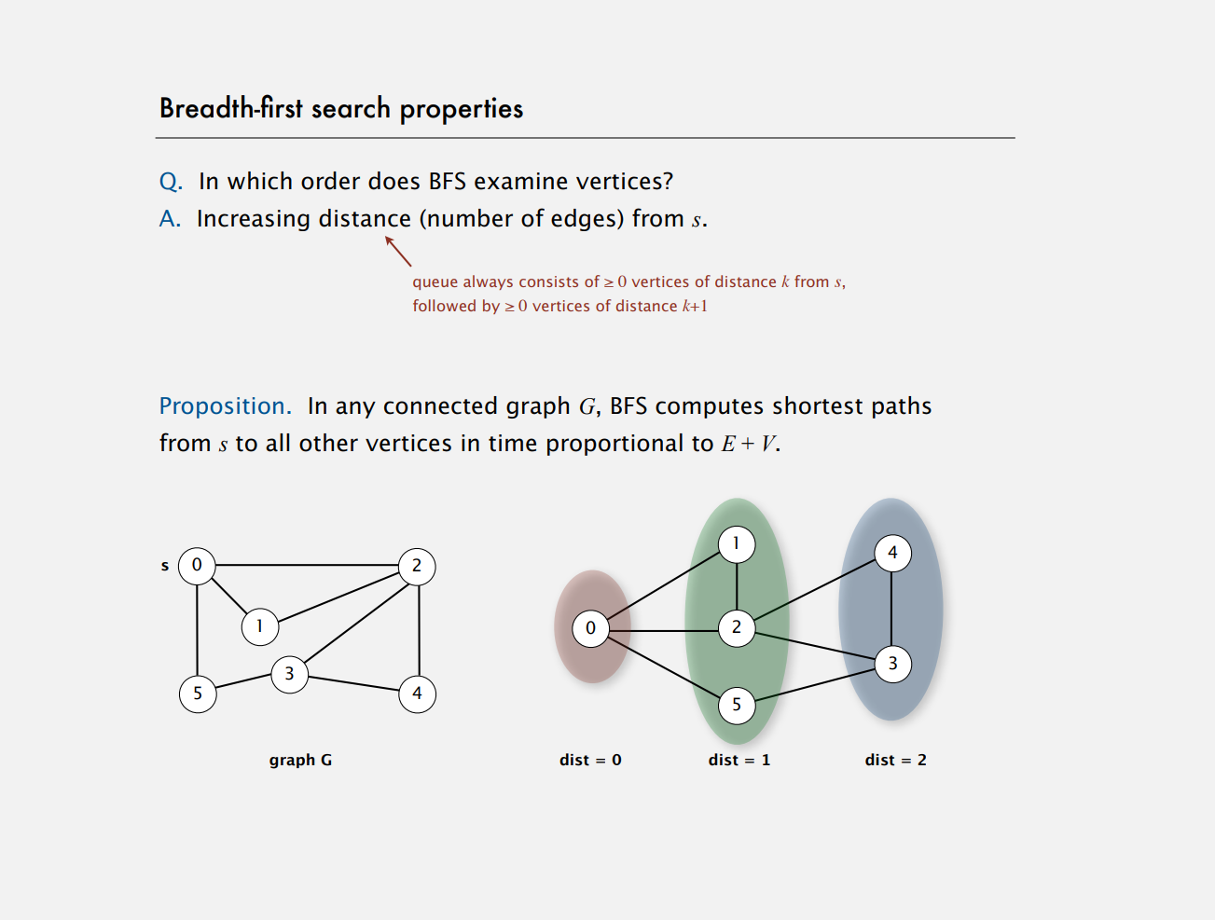
Notes:
linked list
BFS DFS

Slide 12
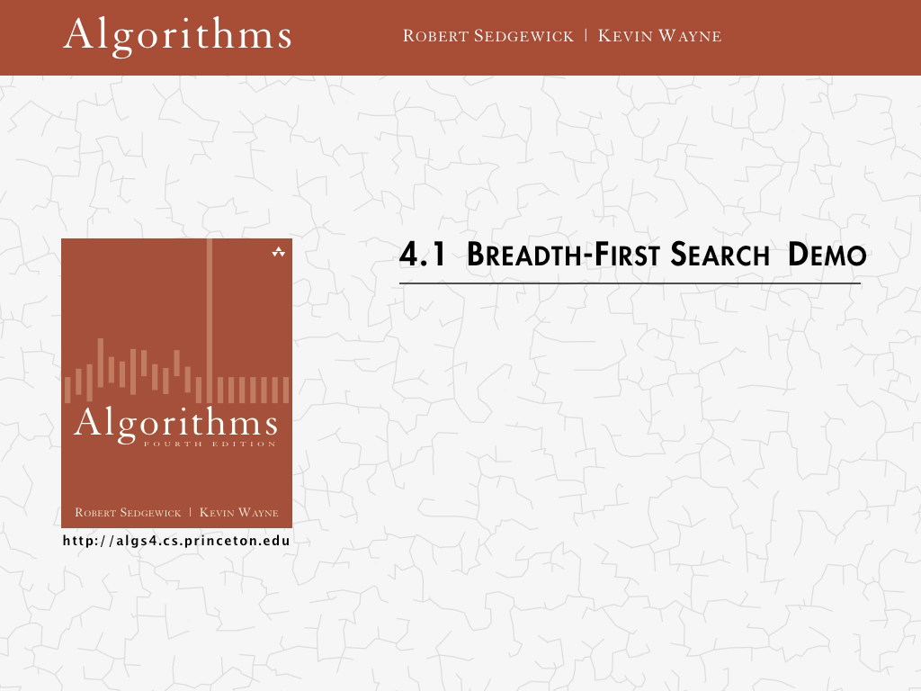
Notes:
linked list
BFS DFS

Slide 13
Other Classical Problems in Graph：Example
Topology Sort
DFS + Reverse Post Order
Minimum Spanning Tree
Greedy / Kruskal / Prim
Shortest Path
Dijkstra / Acyclic / Bellman-Ford

Slide 14
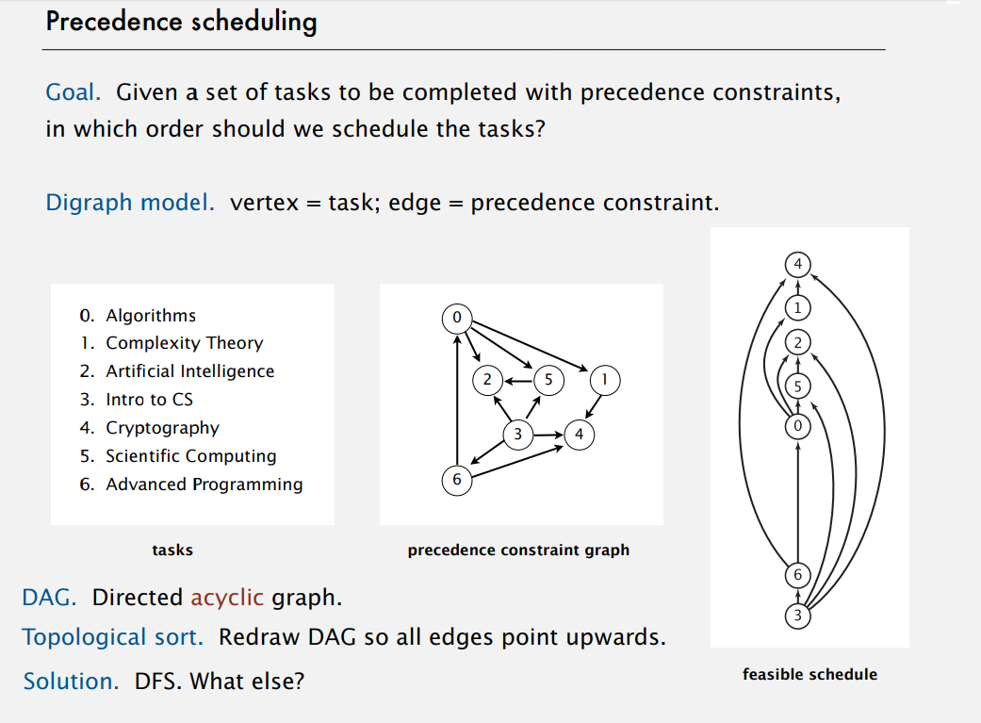

Slide 15
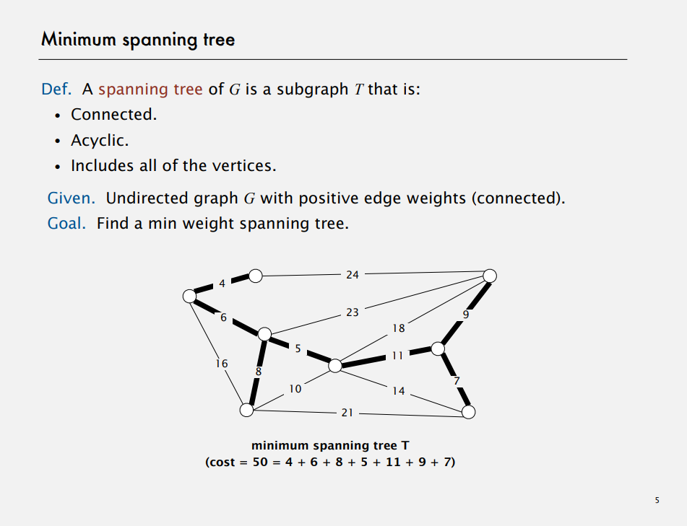

Slide 16
Clever Tricks in Algorithm Example: Hare & Tortoise Algorithm
https://leetcode.com/problems/linked-list-cycle/
https://leetcode.com/problems/linked-list-cycle-ii/

Slide 17
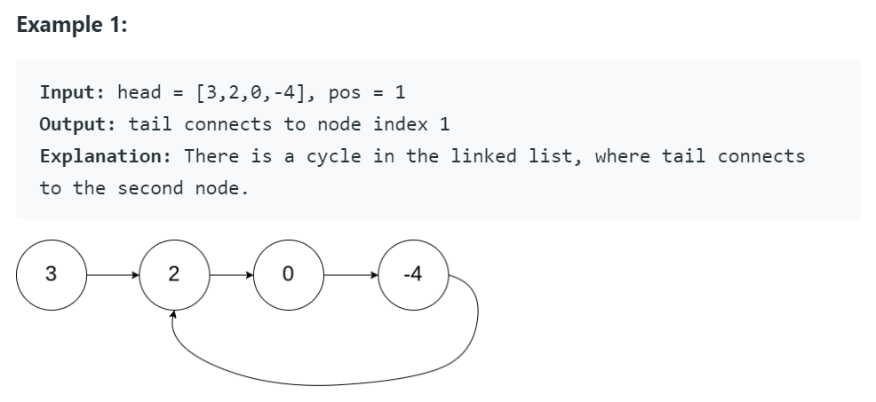
Problem Formulation
Given a linked list, return the node where the cycle begins. If there is no cycle, return null.

Slide 18

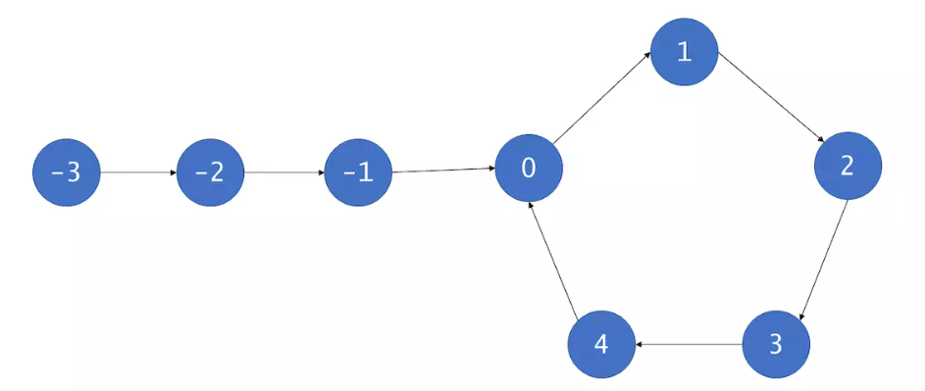

Solution
Tortoise moves one hop each time
Hare moves two hops each time

Slide 19
Solution
Tortoise moves one hop each time
Hare moves two hops each time

Slide 20
Solution
Tortoise moves one hop each time
Hare moves two hops each time

Slide 21
Solution
Tortoise moves one hop each time
Hare moves two hops each time

Slide 22
Solution
Tortoise moves one hop each time
Hare moves two hops each time

Slide 23
Solution
Tortoise moves one hop each time
Hare moves two hops each time
Ring Exists!

Slide 24
Solution
Tortoise moves one hop each time
Hare moves one hops each time
Move the hare back to the beginning

Slide 25
Solution
Tortoise moves one hop each time
Hare moves one hops each time

Slide 26
Solution
Tortoise moves one hop each time
Hare moves one hops each time

Slide 27
Solution
Tortoise moves one hop each time
Hare moves one hops each time
Ring Starts Here!

Slide 28
Algorithmic Techniques
Brute-force algorithms
Take the most direct or obvious solution approach
Enumerate all possible candidate solutions
Divide-and-conquer algorithms
break problem down into sub-problems that similar to the original problem, but smaller in size
Typically leads to recursive algorithms
E.g., MERGESORT
Greedy algorithms
Often applied to optimization problems involving a sequence of choices
At each step, the locally optimal choice is made
Dynamic programming algorithms
Break problem down into sub-problems
Use the solutions to these sub-problems to solve larger sub-problems (reusing results)

Slide 29
Greedy Algorithm: Change Making
Given coins of denominations 1,5,10,25 cents; find out a way to give a customer an amount with the fewest number of coins.
Example: 147 cents

Slide 30
Dynamic programming : Fibonacci Sequence
The Fibonacci Sequence is the series of numbers:
0, 1, 1, 2, 3, 5, 8, 13, 21, 34, ...
The next number is found by adding up the two numbers before it:
the 2 is found by adding the two numbers before it (1+1),
the 3 is found by adding the two numbers before it (1+2),
the 5 is (2+3),
and so on!

Slide 31
Exercise / Q&A
Notes:
linked list
BFS DFS

Slide 32
ADDITIONAL MATERIAL

Slide 33
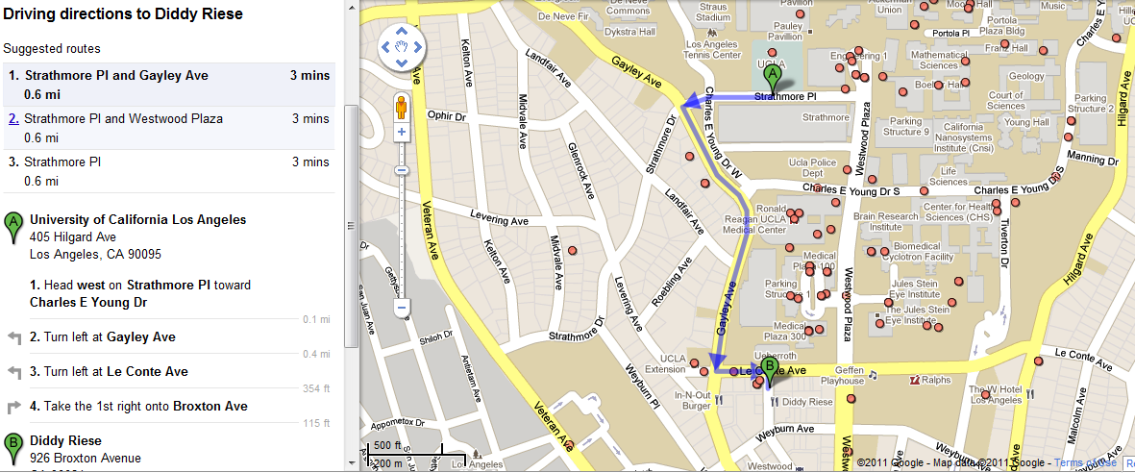

Shortest-Path Problem
Google Maps - determining the fastest route
www.variability.org

Slide 34
Shortest-Path Problem
Google Maps - determining the fastest route
www.variability.org

Slide 35
Class Activity: Shortest Path Algorithm
Can you come up with an algorithm that solves the shortest path problem?
Work in groups
What is the shortest path from s to t?
Example and Animation are from National University of Singapore
2
24
3
9
s
18
14
6
6
2
30
4
19
11
15
5
5
6
20
16
7
t
44

Slide 36
Dijsktra’s Shortest Path Algorithm
Find shortest path from s to t.
2
24
3
9
s
18
14
6
6
2
30
4
19
11
15
5
5
6
20
16
7
t
44
Example and Animation are from National University of Singapore

Slide 37
Dijsktra’s Shortest Path Algorithm
S = { }
PQ = { s, 2, 3, 4, 5, 6, 7, t }
B = { }
∞
∞
0
2
24
3
9
s
∞
18
14
6
6
2
∞
∞
4
30
19
11
15
5
5
6
20
16
7
t
distance label
44
∞
∞
Example and Animation are from National University of Singapore

Slide 38
Dijsktra’s Shortest Path Algorithm
S = { }
PQ = { s, 2, 3, 4, 5, 6, 7, t }
B = { }
dmin
∞
∞
0
2
24
3
9
s
∞
18
14
6
6
2
∞
∞
30
4
19
11
15
5
5
6
20
16
7
t
distance label
∞
44
∞
Example and Animation are from National University of Singapore

Slide 39
Dijsktra’s Shortest Path Algorithm
S = { s }
PQ = { 2, 3, 4, 5, 6, 7, t }
B = { s }
decrease key
∞
∞
9
0
X
2
24
3
9
s
14
∞
18
14
X
6
6
2
∞
∞
30
4
19
11
15
5
5
6
20
16
7
15
t
44
∞
distance label
∞
X
Example and Animation are from National University of Singapore

Slide 40
Dijsktra’s Shortest Path Algorithm
S = { s }
PQ = { 2, 3, 4, 5, 6, 7, t }
B = { s }
dmin
∞
∞
9
0
X
2
24
3
9
s
14
∞
18
14
X
6
6
2
∞
∞
4
30
19
11
15
5
5
6
20
16
7
15
t
44
distance label
∞
∞
X
Example and Animation are from National University of Singapore

Slide 41
Dijsktra’s Shortest Path Algorithm
S = { s, 2 }
PQ = { 3, 4, 5, 6, 7, t }
B = { s, 2 }
∞
∞
9
X
2
24
3
0
9
s
∞
14
18
14
X
6
6
2
∞
30
∞
4
19
11
15
5
5
6
20
16
7
t
44
∞
15
∞
X
Example and Animation are from National University of Singapore

Slide 42
Dijsktra’s Shortest Path Algorithm
S = { s, 2 }
PQ = { 3, 4, 5, 6, 7, t }
B = { s, 2 }
decrease key
∞
33
∞
X
9
X
2
24
3
0
9
s
∞
14
18
14
X
6
6
2
∞
30
∞
4
19
11
15
5
5
6
20
16
7
t
44
∞
15
∞
X
Example and Animation are from National University of Singapore

Slide 43
Dijsktra’s Shortest Path Algorithm
S = { s, 2 }
PQ = { 3, 4, 5, 6, 7, t }
B = { s, 2 }
∞
33
∞
X
9
X
2
24
3
0
9
dmin
s
∞
14
18
14
X
6
6
2
∞
30
∞
4
19
11
15
5
5
6
20
16
7
t
44
∞
15
∞
X
Example and Animation are from National University of Singapore

Slide 44
Dijsktra’s Shortest Path Algorithm
S = { s, 2, 6 }
PQ = { 3, 4, 5, 7, t }
B = { s, 6 }
32
∞
33
∞
X
X
9
X
2
24
3
0
9
s
∞
14
18
14
X
6
6
2
44
∞
∞
4
30
X
19
11
15
5
5
6
20
16
7
t
44
∞
15
∞
X
Example and Animation are from National University of Singapore

Slide 45
Dijsktra’s Shortest Path Algorithm
S = { s, 2, 6 }
PQ = { 3, 4, 5, 7, t }
B = { s, 6 }
32
∞
33
∞
X
X
9
X
2
24
3
0
9
s
∞
14
18
14
X
6
6
2
44
∞
∞
4
30
X
19
11
15
5
5
6
20
16
7
t
44
∞
15
dmin
∞
X
Example and Animation are from National University of Singapore

Slide 46
Dijsktra’s Shortest Path Algorithm
S = { s, 2, 6, 7 }
PQ = { 3, 4, 5, t }
B = { s, 7 }
32
∞
33
∞
X
X
9
X
2
24
3
0
9
s
∞
14
18
14
X
6
6
2
44
35
∞
X
∞
4
30
X
19
11
15
5
5
6
20
16
7
t
44
59
∞
∞
15
X
X
Example and Animation are from National University of Singapore

Slide 47
Dijsktra’s Shortest Path Algorithm
S = { s, 2, 6, 7 }
PQ = { 3, 4, 5, t }
B = { s, 7 }
dmin
32
∞
33
∞
X
X
9
X
2
24
3
0
9
s
∞
14
18
14
X
6
6
2
44
35
∞
X
∞
4
30
X
19
11
15
5
5
6
20
16
7
t
44
59
∞
∞
15
X
X
Example and Animation are from National University of Singapore

Slide 48
Dijsktra’s Shortest Path Algorithm
S = { s, 2, 3, 6, 7 }
PQ = { 4, 5, t }
B = { s, 6, 3 }
32
∞
33
∞
X
X
9
X
2
24
3
0
9
s
∞
14
18
14
X
6
6
2
44
35
34
∞
X
X
∞
4
30
X
19
11
15
5
5
6
20
16
7
t
44
51
59
∞
∞
15
X
X
X
Example and Animation are from National University of Singapore

Slide 49
Dijsktra’s Shortest Path Algorithm
S = { s, 2, 3, 6, 7 }
PQ = { 4, 5, t }
B = { s, 6, 3 }
32
∞
33
∞
X
X
9
X
2
24
3
0
9
s
∞
14
18
14
X
6
6
2
44
35
34
∞
X
X
∞
4
30
X
19
11
15
5
5
6
20
dmin
16
7
t
44
51
59
∞
∞
15
X
X
X
Example and Animation are from National University of Singapore

Slide 50
Dijsktra’s Shortest Path Algorithm
S = { s, 2, 3, 5, 6, 7 }
PQ = { 4, t }
B = { s, 6, 3, 5 }
32
∞
33
∞
X
X
9
X
2
24
3
0
9
s
∞
14
18
14
X
6
6
2
35
34
45
∞
44
X
X
X
∞
4
30
X
19
11
15
5
5
6
20
16
7
t
44
50
51
59
∞
∞
15
X
X
X
X
Example and Animation are from National University of Singapore

Slide 51
Dijsktra’s Shortest Path Algorithm
S = { s, 2, 3, 5, 6, 7 }
PQ = { 4, t }
B = { s, 6, 3, 5 }
32
∞
33
∞
X
X
9
X
2
24
3
0
9
s
∞
14
18
14
X
6
6
2
35
34
45
∞
44
X
X
X
∞
4
30
X
19
11
15
5
dmin
5
6
20
16
7
t
44
50
51
59
∞
∞
15
X
X
X
X
Example and Animation are from National University of Singapore

Slide 52
Dijsktra’s Shortest Path Algorithm
S = { s, 2, 3, 4, 5, 6, 7 }
PQ = { t }
B = { s, 6, 3, 5, 4 }
32
∞
33
∞
X
X
9
X
2
24
3
0
9
s
∞
14
18
14
X
6
6
2
35
34
45
∞
44
X
X
X
∞
4
30
X
19
11
15
5
5
6
20
16
7
t
44
50
51
59
∞
∞
15
X
X
X
X
Example and Animation are from National University of Singapore

Slide 53
Dijsktra’s Shortest Path Algorithm
S = { s, 2, 3, 4, 5, 6, 7 }
PQ = { t }
B = { s, 6, 3, 5, 4 }
32
∞
33
∞
X
X
9
X
2
24
3
0
9
s
∞
14
18
14
X
6
6
2
35
34
45
∞
44
X
X
X
∞
4
30
X
19
11
15
5
5
6
20
16
7
t
44
dmin
50
51
59
∞
∞
15
X
X
X
X

Slide 54
Dijsktra’s Shortest Path Algorithm
S = { s, 2, 3, 4, 5, 6, 7, t }
PQ = { }
B = { s, 6, 3, 5, t }
32
∞
33
∞
X
X
9
X
2
24
3
0
9
s
∞
14
18
14
X
6
6
2
35
34
45
∞
44
X
X
X
∞
4
30
X
19
11
15
5
5
6
20
16
7
t
44
50
51
59
∞
∞
15
X
X
X
X

Slide 55
Dijsktra’s Shortest Path Algorithm
S = { s, 2, 3, 4, 5, 6, 7, t }
PQ = { }
B = { s, 6, 3, 5, t }
32
∞
33
∞
X
X
9
X
2
24
3
0
9
s
∞
14
18
14
X
6
6
2
35
34
45
∞
44
X
X
X
∞
4
30
X
19
11
15
5
5
6
20
16
7
t
44
50
51
59
∞
∞
15
X
X
X
X
Example and Animation are from National University of Singapore

Slide 56
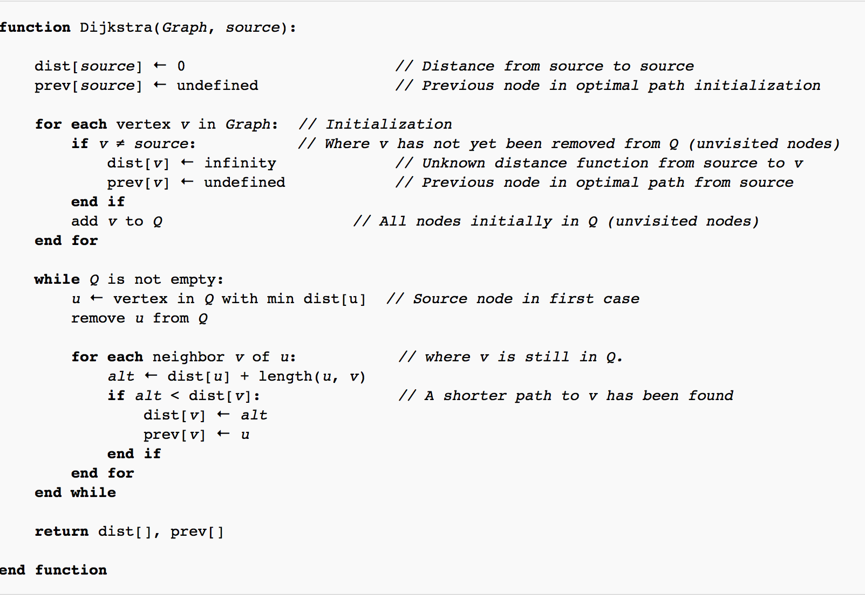
Dijsktra’s Shortest Path Algorithm
Source: https://en.wikipedia.org/wiki/Dijkstra%27s_algorithm

Slide 57
Importance of Efficiency
Computers have finite speed, finite memory.
Need to minimize amount of computation that the machines needs to make.
Algorithm X executes in 10n² + n / 3.7 + 22 steps
Algorithm Y executes in 100n log n + 14n + 22 steps
Which algorithm is better?
www.variability.org

Slide 58
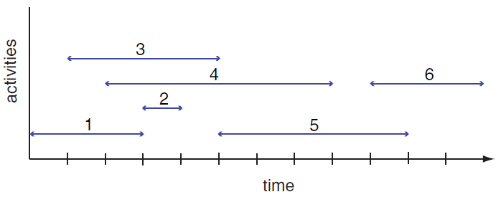
Greedy Algorithm
Activity Selection Problem
Given: A set of proposed activities that wish to use a resource, which can only be used by one activity at a time
Problem: Find maximum-size set of activities that do not have a time conflict

Slide 59
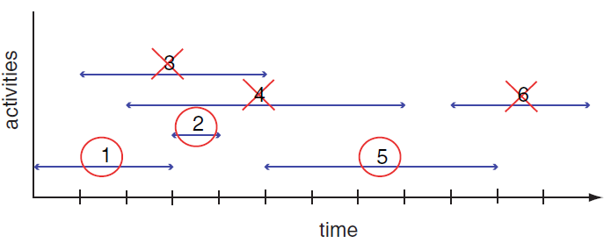
Greedy Algorithm
Greedy choice: Pick the remaining compatible activity that has the earliest finish time
Can you write an algorithm that does this?
Notes:
Tasks ordered by finish time

Slide 60
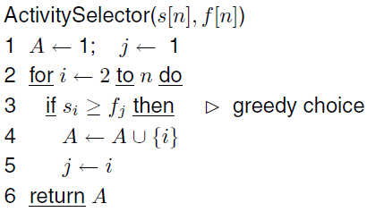
Algorithm for Activity Selection Problem
What is the running time for this algorithm?

Slide 61
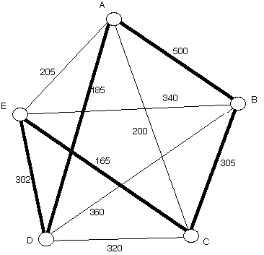
Nearest Neighbor Algorithm
Start at a vertex
Find the lightest edge connecting the current vertex and an unvisited vertex V
Set current vertex to V
Mark V as visited
Terminate when all the vertices have been visited
Repeat from step 2
Example: Starts from Vertex A and returns
to starting point at the end
Path: A - D - E - C - B - A

Slide 62
Deficiencies of Nearest Neighbor
Worst case: algorithm can result in a path much longer than the optimal path
Won’t work in case of incomplete graph
When some cities are not connected
Any ideas for a better algorithm?
Notes:
https://web.tuke.sk/fei-cit/butka/hop/htsp.pdf

